Slide 1

Mental Health Counseling Center Web Application
A Comprehensive Platform for Counselors, Patients, and Administrators

Slide 2
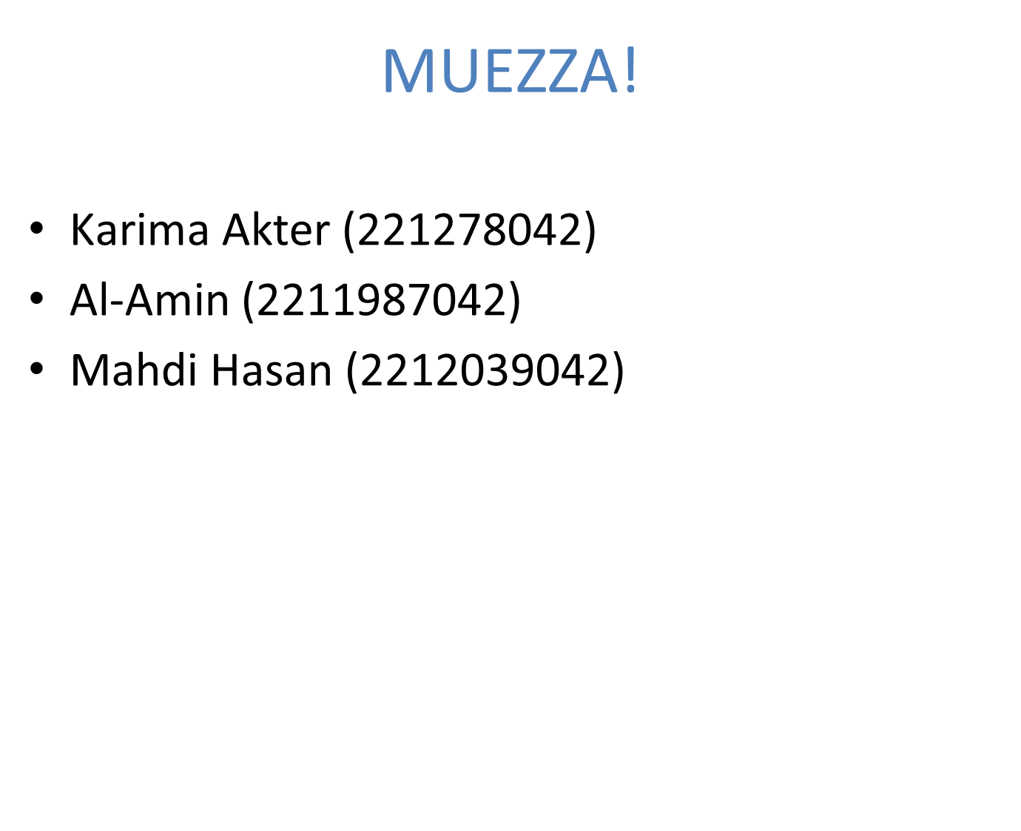


Slide 3
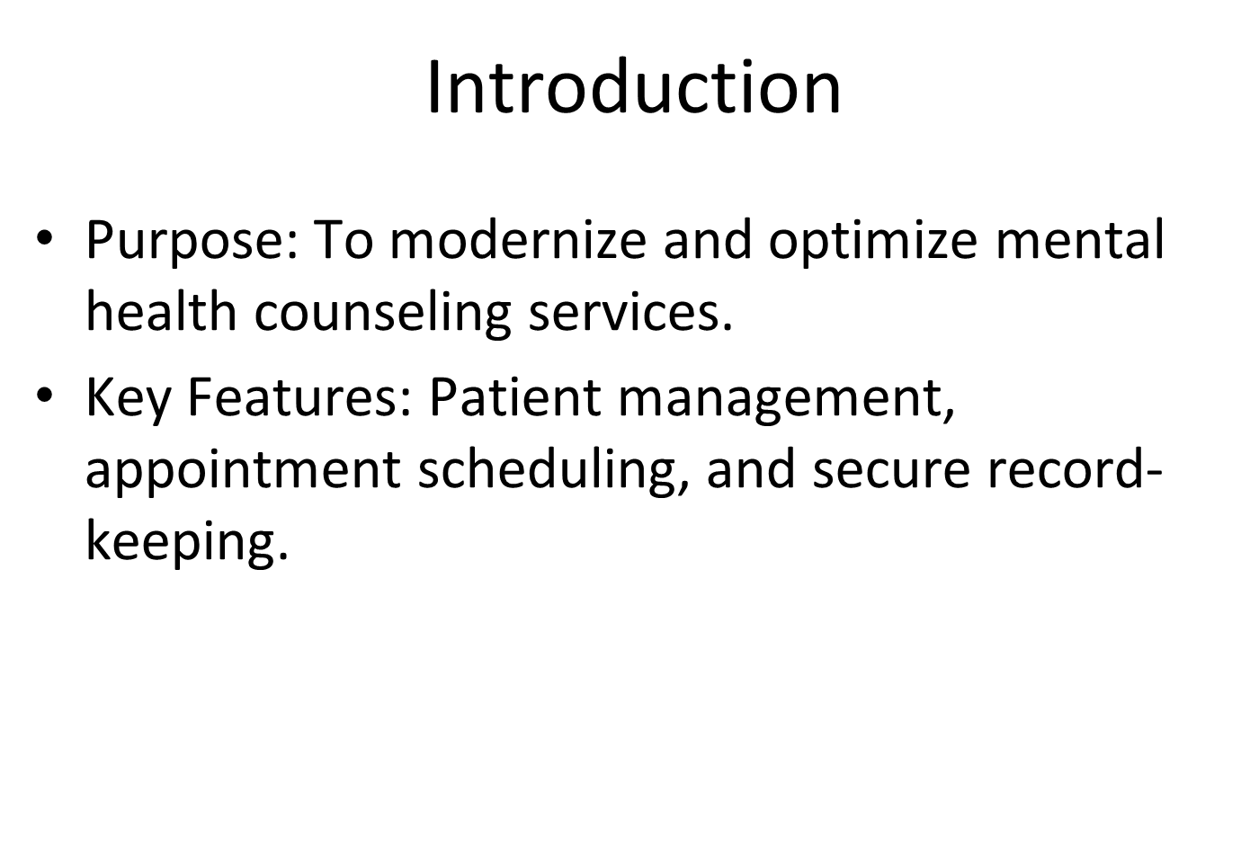

Slide 4
Problem Statement
Many People face mental health challenges, but they often don’t seek help because of stigma, difficulty accessing services, or not knowing where to find help. Existing counseling services may not reach enough people, struggle to manage appointments well, or fail to provide a simple and personalized experience. This leaves many People without the support they need, which can harm their studies, relationships, and overall well-being.

Slide 5
Vision statements findings
For: individuals experiencing mental health challenges or seeking emotional well-being.
Who: need accessible, professional, and compassionate mental health support.
The [Mental Health Counseling Center ] is an online platform
That: offers personalized counseling services, self-help resources, and real-time support through an intuitive and confidential interface.
Unlike: traditional counseling platforms that may lack accessibility, affordability, or personalized care,
Our product: provides a holistic and user-friendly solution, integrating licensed professionals, secure communication tools, and curated resources to empower users in their mental health journey.

Slide 6
Vision Statement
We want to make a platform for the people in need of mental health support. Our web app provides a holistic system with a safe space for emotional support, prioritizing mental wellness, and promoting a culture of mental health care unlike the current apps.
We want to make a platform for the people in need of mental health support. Our web app provides a holistic system with a safe space for emotional support, prioritizing mental wellness, and promoting a culture of mental health care unlike the current apps.

Slide 7
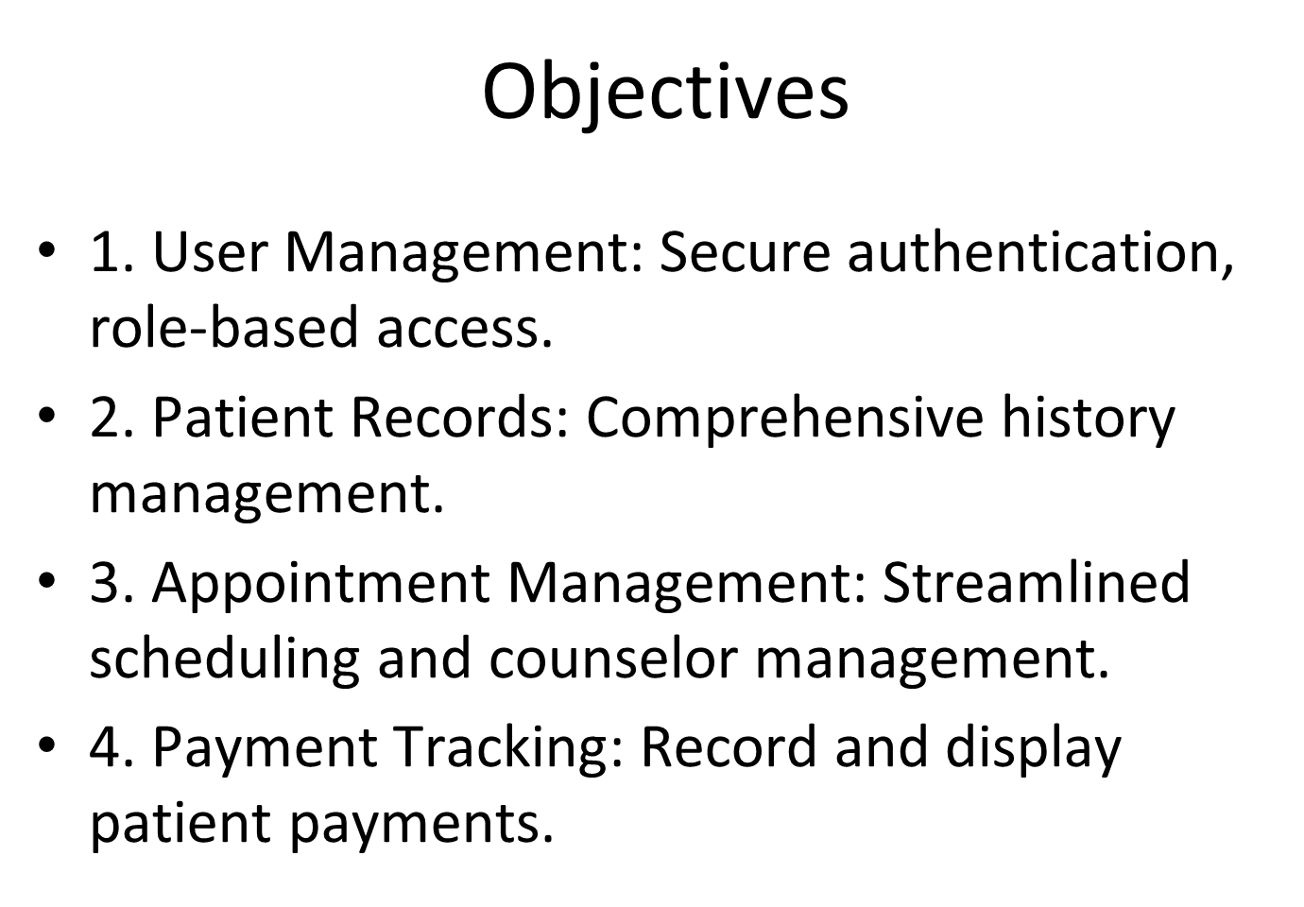

Slide 8
Platform Comparison Table
Platform | Communication Methods | Pros | Cons
BetterHelp | Text messaging, live sessions (video, phone, chat) | Convenient access from anywhere; More affordable than traditional therapy, newsletter type set up, automated email reply with easy access to all features, Very simple walkthrough to set up an appointment with or without an initial test. | Therapists may not respond immediately; Not suitable for severe cases, response rate is slow In the UI, questionnaire visibility problem, UI has no home button or any back button, No anonymous option, cannot select therapist, cannot change therapist.
Online-Therapy.com | Worksheets, journaling, messaging, video | Structured, evidence-based therapy (CBT); Affordable with various plans, have user log in system, fast response time, have verification with email, can change the therapist | Limited therapist interaction on lower plans; Not ideal for severe cases, no home button and no home page after log in. Just one way structured, no back button
ReGain | Text, phone, video | Focused on couples therapy; Affordable and convenient for couples, have verification process, can change therapist at any time | Delayed responses in messaging; Not suitable for severe relationship issues, no back button, no home page, response rate is slow In the UI, UI is not organized
Brightside | Messaging, video, psychiatry consultations | Integrated therapy and medication management; Personalized, evidence-based treatment | Focused only on anxiety and depression; No insurance coverage, no back button, no home page, response rate is slow In the UI, UI is not organized

Slide 9
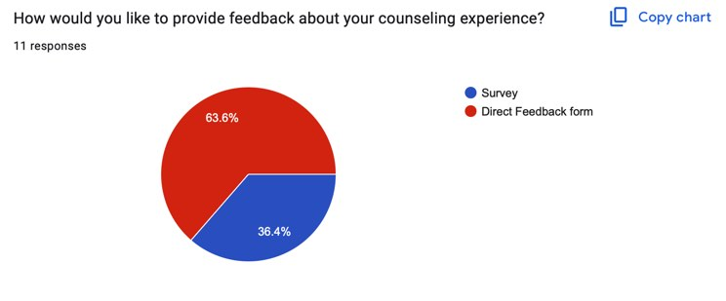
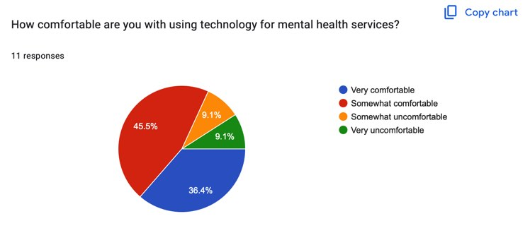
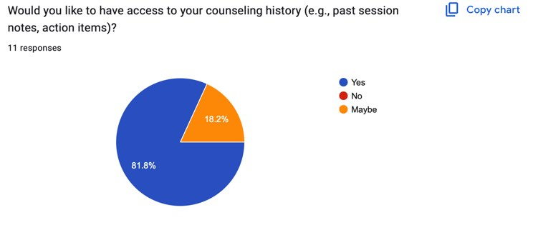
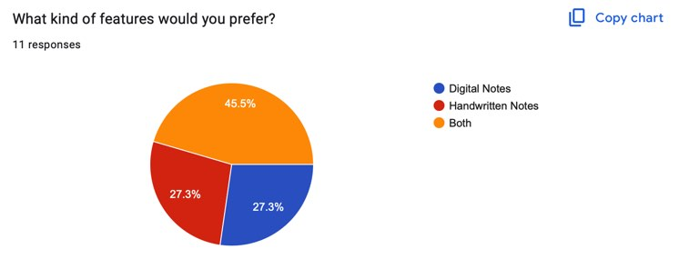
Survey

Slide 10
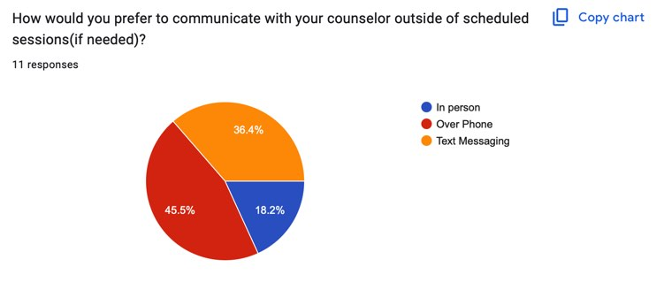
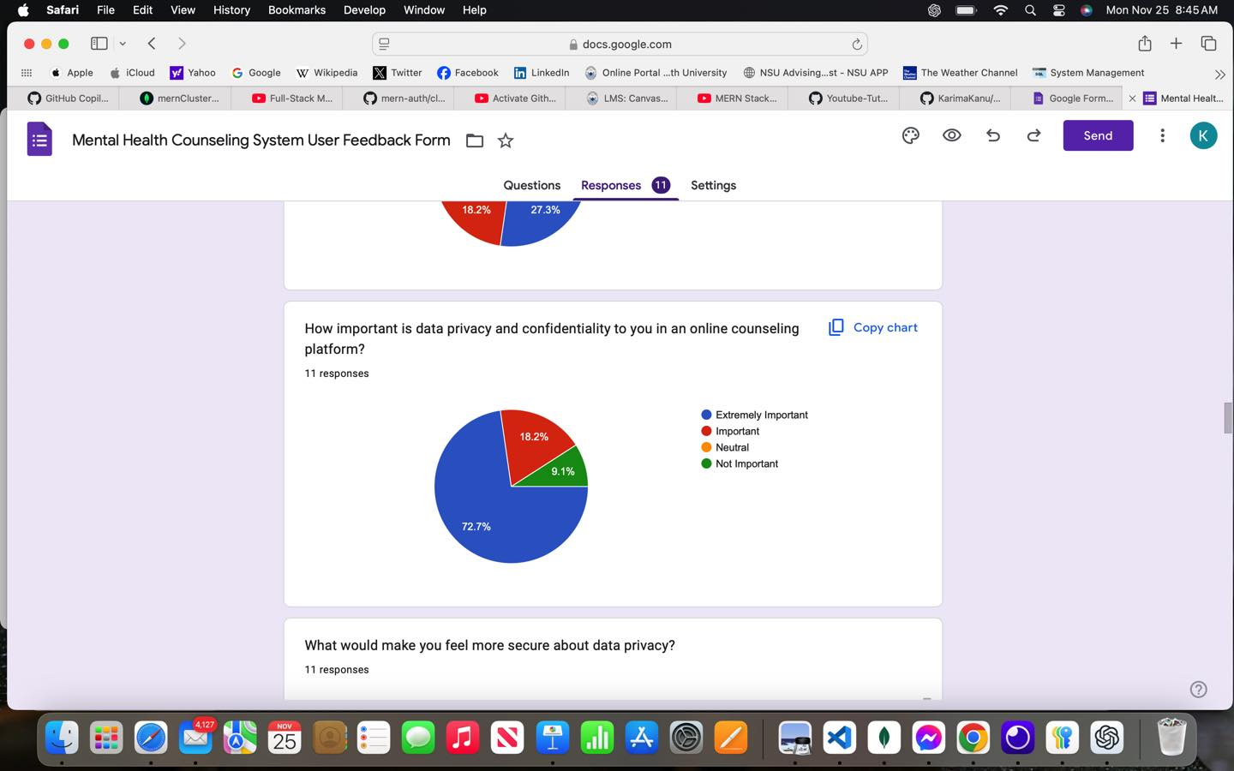
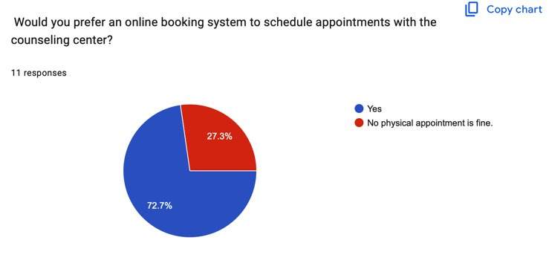
Survey

Slide 11

Functional Requirements Key Functional Requirements
User Management: Secure registration, login, and role-based functionality.
Patient Records: Maintain session updates and mental health history.
Appointment Management: Book, approve/reject, and reassign slots with search and filter.
Payment Tracking: Record payments, support MFS/card options, and manage records.
Role-Specific Functionalities: Tailored features for patients, counselors, and administrators.

Slide 12
Non-Functional Requirements Quality Attributes and Constraints
Performance: Handles 30,000 concurrent users; fast loading times.
Security: Data encryption, database isolation, and authorized access.
Reliability: Regular backups and high availability during peak usage.
Scalability: Future-ready system for user growth.

Slide 13
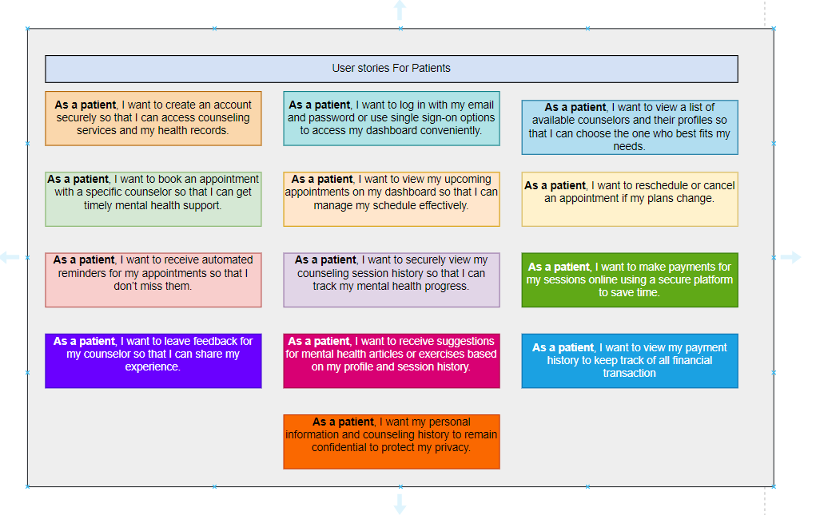
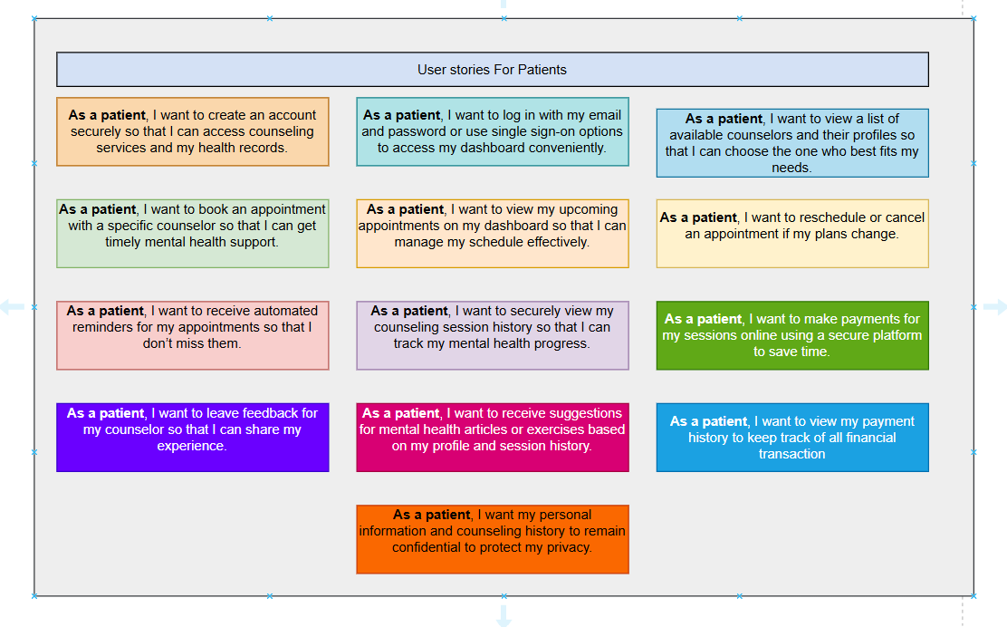
User stories:

Slide 14
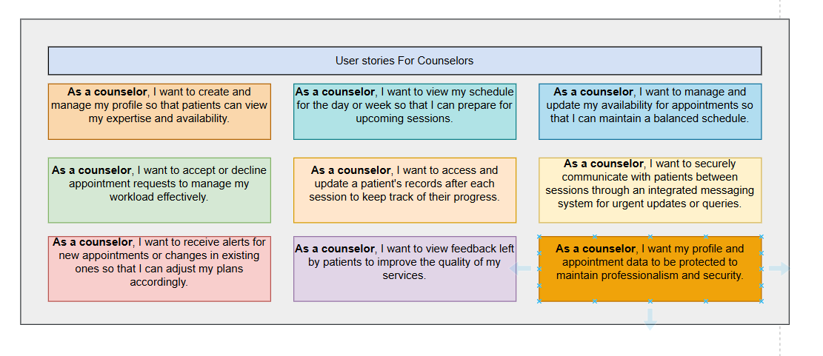
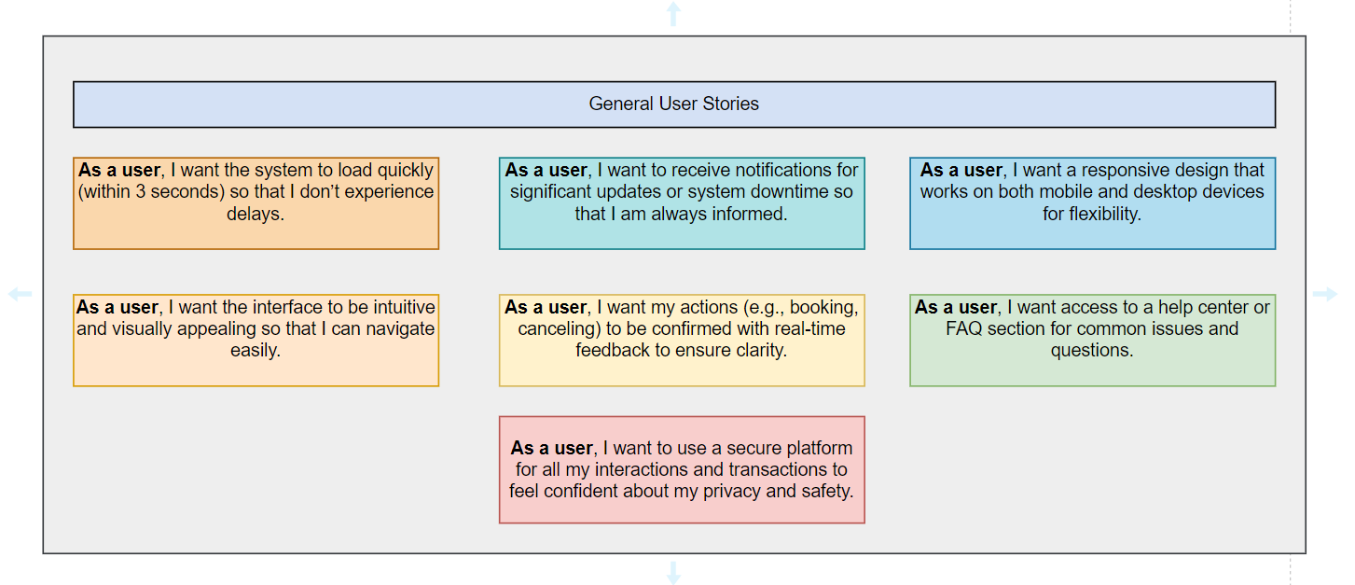
User stories:

Slide 15
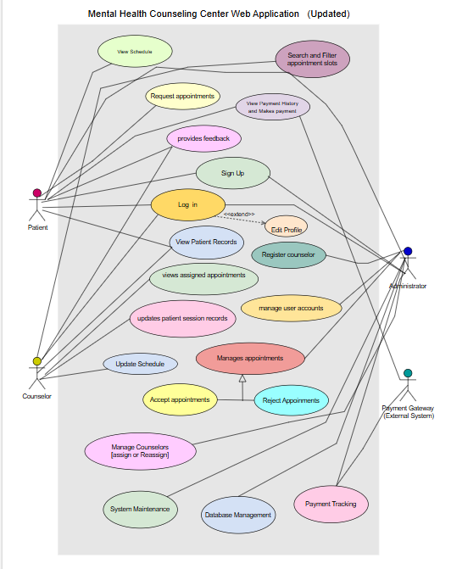
Use Case Diagram:

Slide 16
Use Cases
Patients: Register, request appointments, view payments, and provide feedback.
Counselors: Manage schedules, update records, and give feedback.
Administrators: User management, approve/reject appointments, and system monitoring.

Slide 17
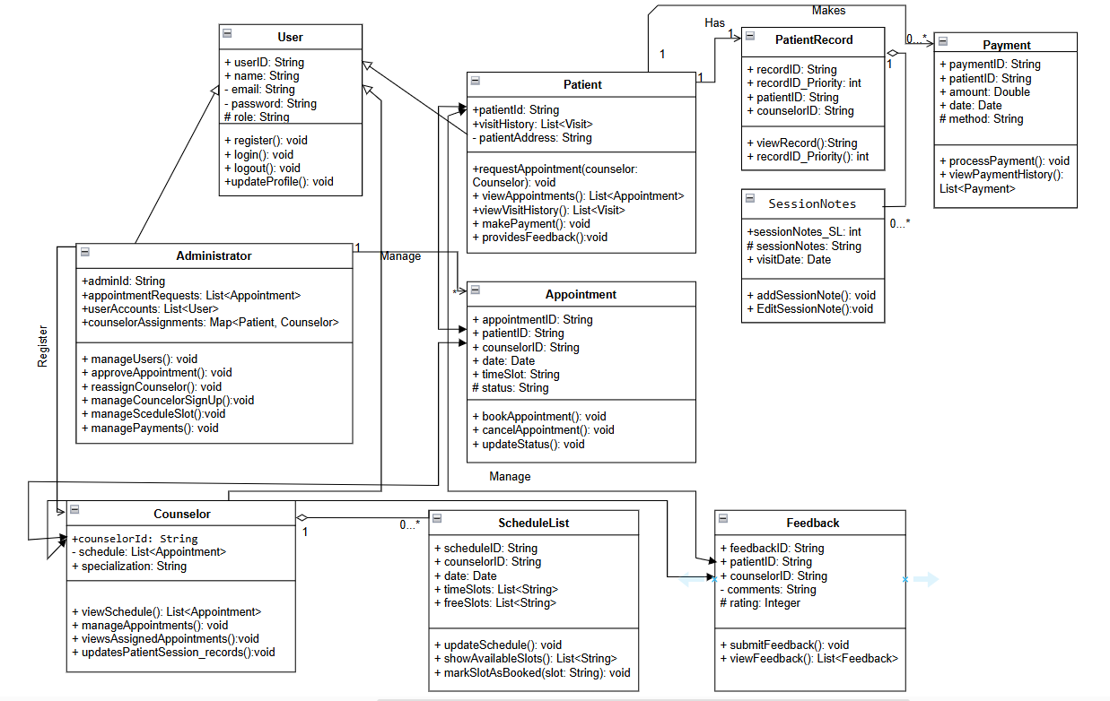
Class Diagram(Updated version):

Slide 18
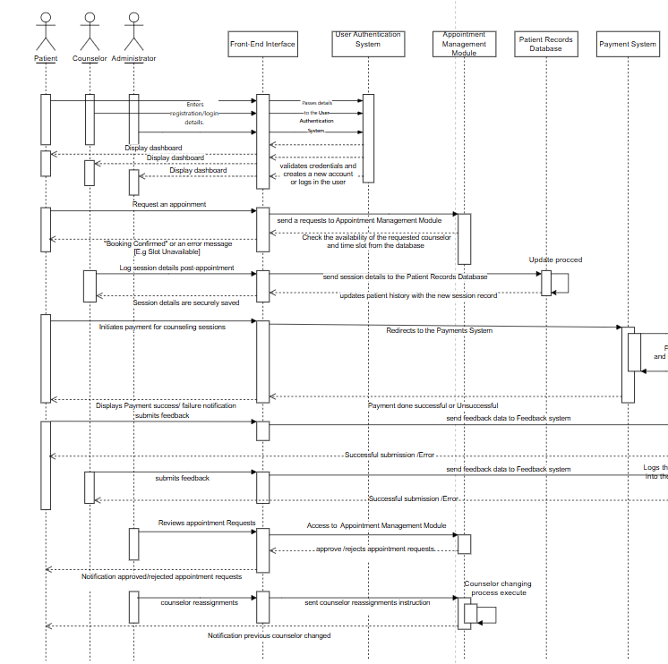
Sequence Diagram:[Full system]

Slide 19
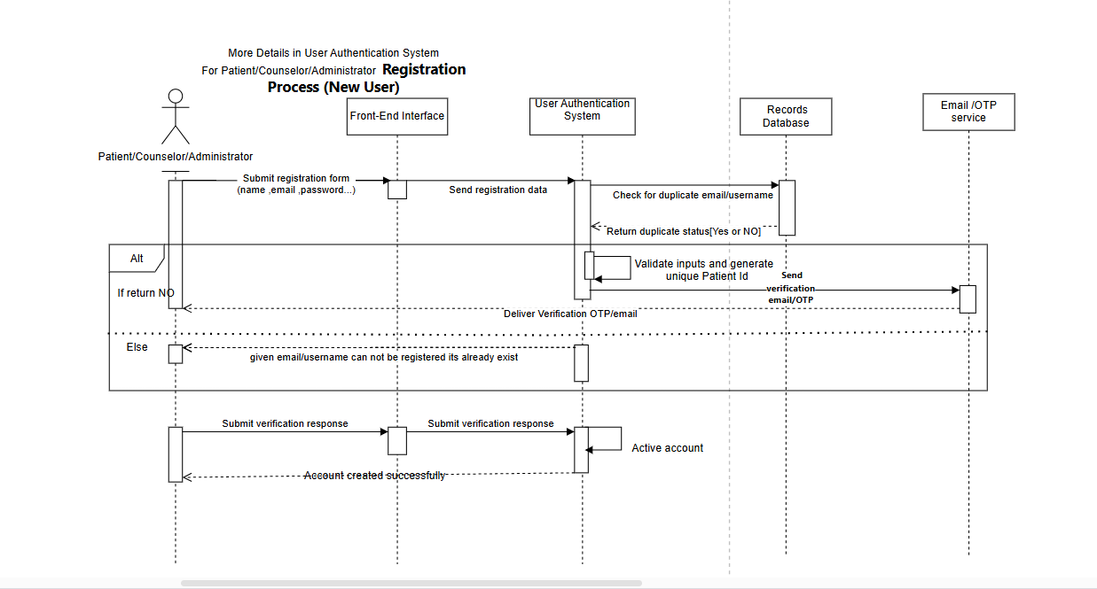
Sequence Diagram:[Registration Process Part]

Slide 20
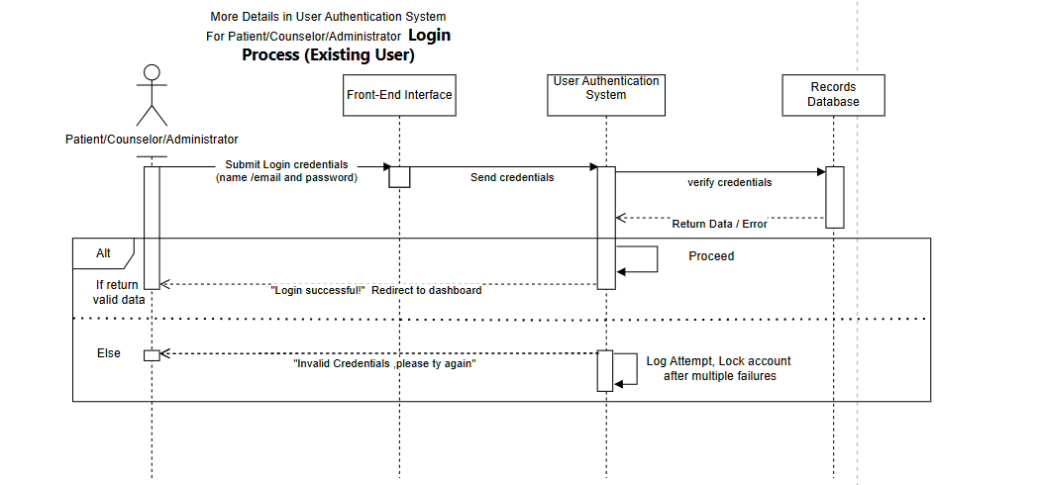
Sequence Diagram:[Log in Process Part]

Slide 21
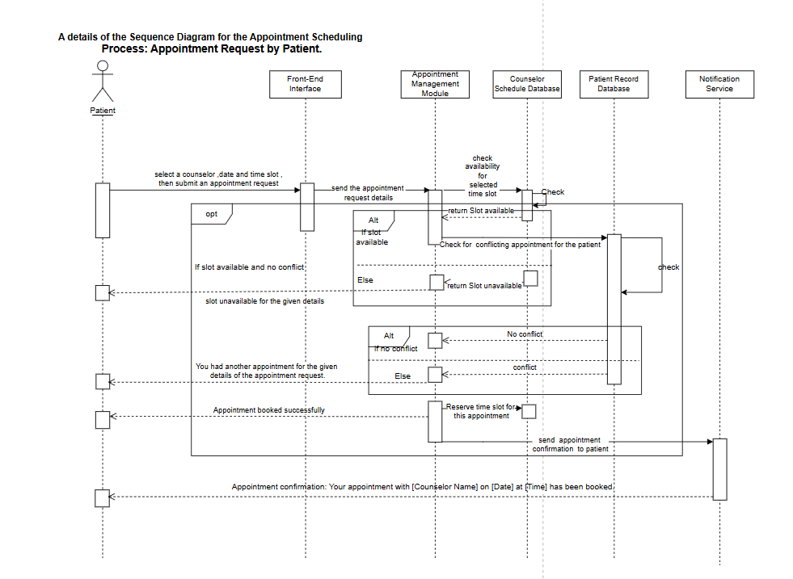
Sequence Diagram:[Appointment Request by Patient_ Part]

Slide 22
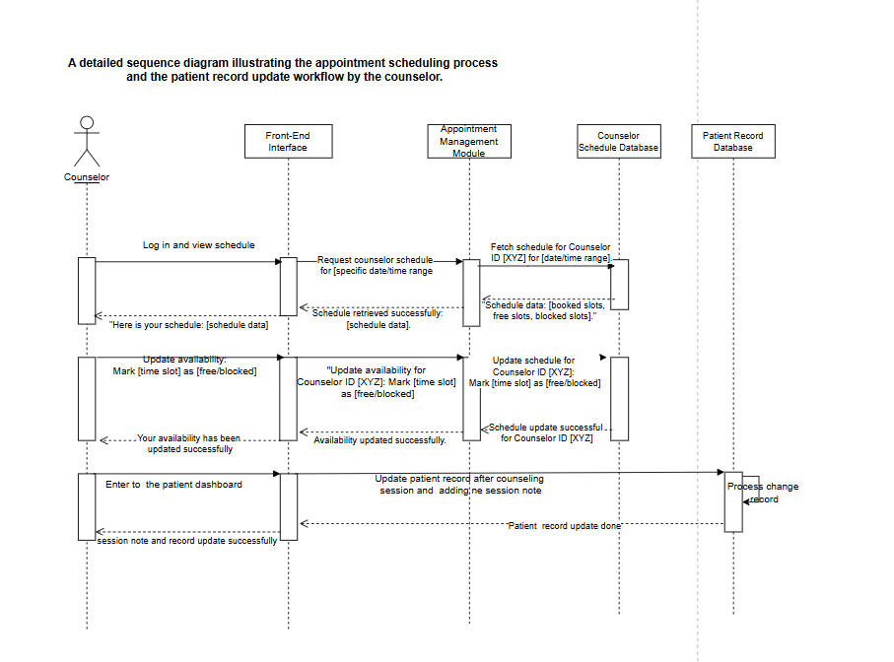
Sequence Diagram:[appointment scheduling process and the patient record update workflow by the counselor_ Part]

Slide 23
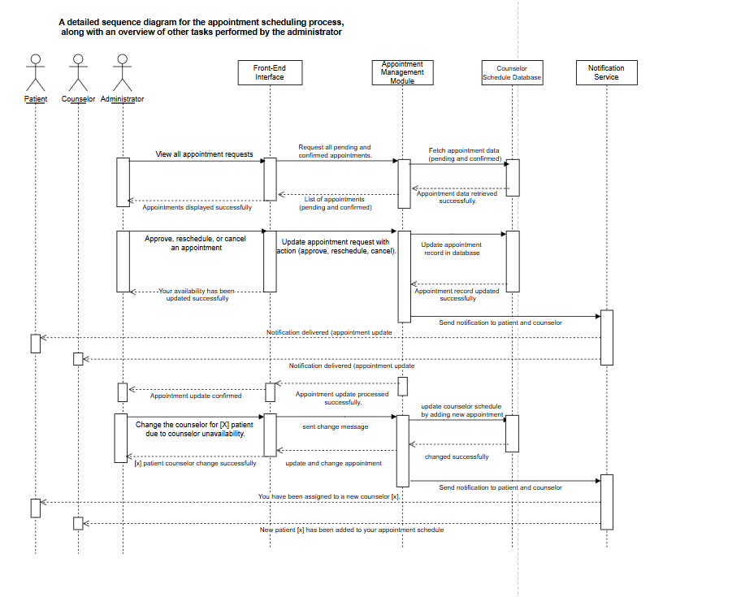
Sequence Diagram:[ appointment scheduling process, along with an overview of other tasks performed by the administrator_ Part]

